Slide 3
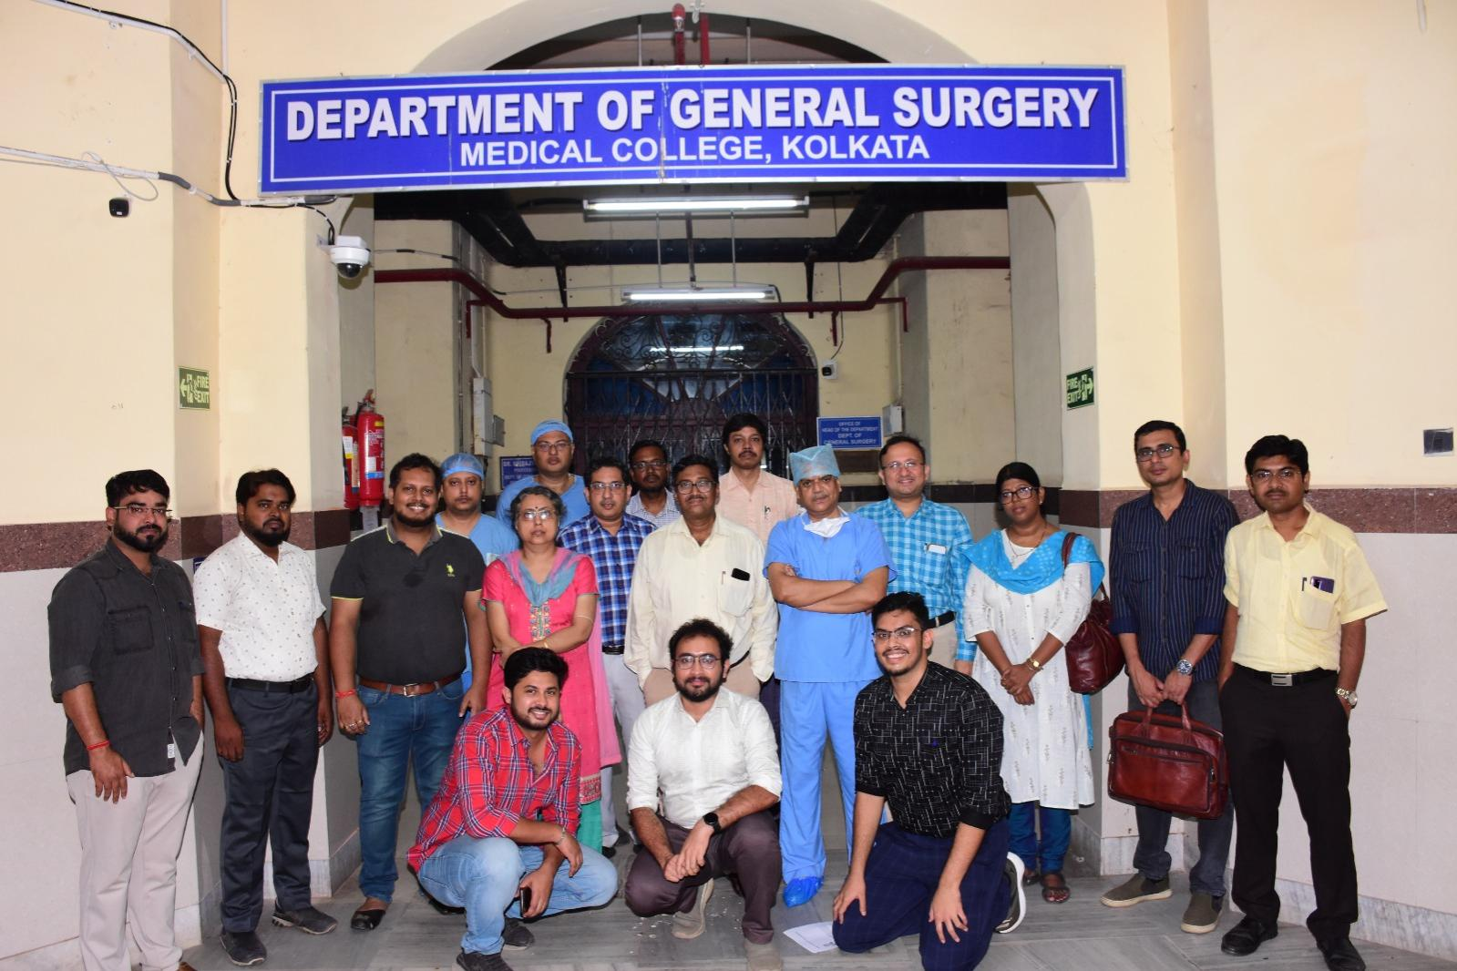
Organizing team:
Department of General Surgery, Medical College Kolkata

